Slide 1
Batch details | PGPDSE FT Online Oct20-B
Team members | Jaydeep Bose Anindita Chatterjee Shubham Das Sushovan Patra Deepsikha Singh
Domain of Project | Marketing and Retail Analytics
Proposed project title | Bank Marketing
Group Number | 4

Slide 2
Problem Definition
BANK MARKETING : Bank Marketing Campaign assists companies to create value for customers and build customer relationships. Our job is to Find the best strategies to improve for the Bank Marketing campaign to have a greater effectiveness in future, by analysis of the last marketing campaign the bank performed and identify the patterns that will helps conclusions.
The Business Problem that we are assessing is direct marketing campaigns banks to approach and subscribe more customers towards Term Deposits. Through this project we tend to analyse the current trend for marketing and its impact on the customer attraction with a scrutinized approach towards the target audience with more returns( new registrations)
What is Term Deposit?: A term deposit is a fixed-term investment that includes the deposit of money into an account at a financial institution. Term deposit investments usually carry short-term maturities ranging from one month to a few years and will have varying levels of required minimum deposits. When a term deposit is purchased, the lender (the customer) understands that the money can only be withdrawn after the term has ended or by giving a predetermined number of days notice. Term deposits are an extremely safe investment and are therefore very appealing to conservative, low-risk investors. Also, there will be a penalty assessed for early termination.
Note:- Typically, term deposits offer higher interest rates than traditional liquid savings accounts, whereby customers can withdraw their money at any time.

Slide 3
Why it is an Important Problem?
Financial institutions such as Banks generate their revenue through lending and borrowing . Lending generates profits in for of interest from customers but some level of risk is involved, that is why machine learning algorithms come in handy in predicting clients who are eligible for loans.
Another form that generates revenue for financial institutions is borrowing or attracting public’s savings into the bank which is a bit less risky than lending. Bank invests the client’s long term deposits into other sectors which brings better returns, where some is payed to the customers.
However when a client does fixed-term deposit, the company gets good returns than savings account as the customer or the client is deprived off the rights to access the money prior to the maturity unless the client is ready to compensate the bank.
Due to this reason, there is a stiff competition between banks to convince clients to do term deposits in their banks, So, the Banks invest in marketing campaigns in reaching out to clients, prospective subscribers and non-prospective ones since the bank doesn’t know who is and who is not.
Role Of Data Science:
With advancement in data science and machine learning and availability of data, the banks are adapting to data-driven decisions and this will help in reducing the cost of marketing thus increasing the revenue of the bank.
In this project, we apply machine learning algorithms to build a predictive model of the dataset in order to provide a necessary suggestion for the marketing campaign team. The goal is to predict whether a client will subscribe a term deposit or not.

Slide 4
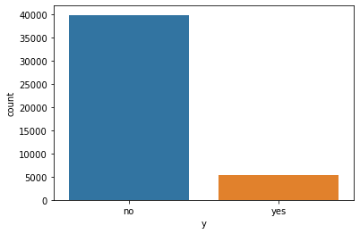
Data set information
The data is related with direct marketing campaigns of a Portuguese banking institution. The marketing campaigns were based on phone calls. Often, more than one contact to the same client was required, in order to assess if the product (bank term deposit) would be ('yes') or not ('no') subscribed.
Number of Instances: 45211
Number of Attributes: 16 independent attribute
10 Categorical and 6 numerical Features
Null Values: Absent
Overall Response Rate = 11.70% subscribers (unbalanced dataset).
Classification Model that is able to identify potential subscribers using mainly two types of variables in the dataset:
❏ client data – Age, Job, Marital, Education, Default, housing Balance , Loan
❏ campaign contact information for the client
(contact, day, month, duration, campaign, pdays, previous, poutcome)
❏ Output variable (desired target):has the client subscribed a term deposit? (binary: "yes","no")

Slide 5
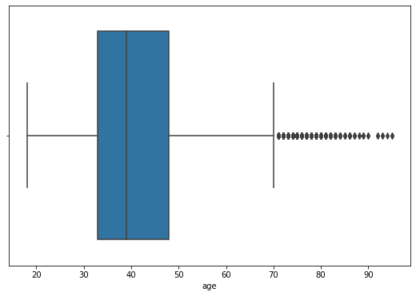
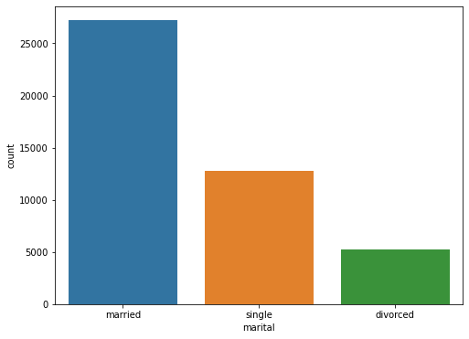
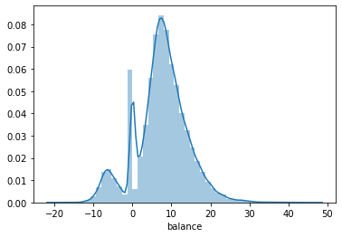
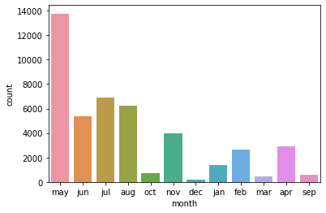
Exploratory Data Analysis(EDA)
Basic EDA and data distribution :
52% of the clients who subscribed were married.
99% of the clients who subscribed did not have any credit default
63% subscribers don’t have housing loans.
93% did not have a personal loan - Low risk Investors
82% of subscribers were contacted via cellular means.
71% of contacts made were between months May and August.
From the age distribution, we concluded the age range, 90% of our data is between 25 to 65 years with many outlying records(as shown) which cannot be neglected.

Slide 6
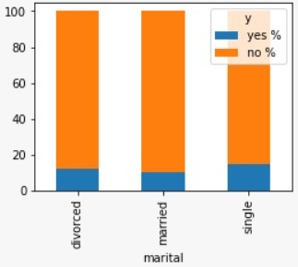
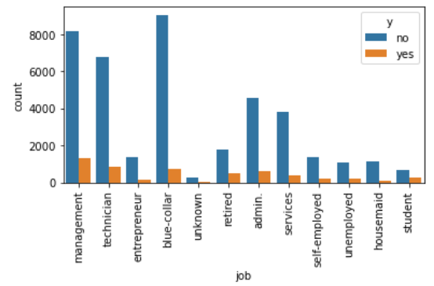
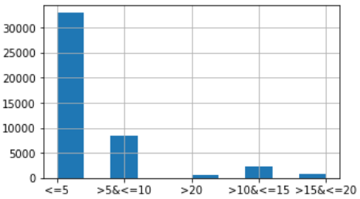
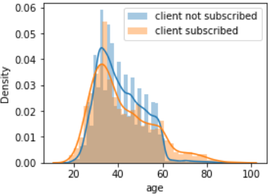
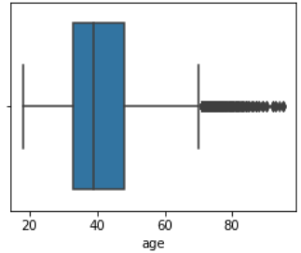
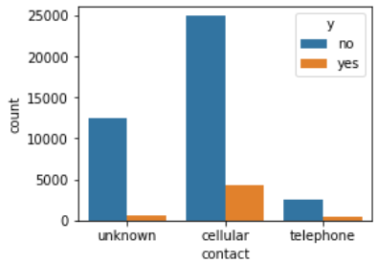
Bivariate Analysis
Marital:
3 unique status.
60% are married, 28% single & rest divorced.
52% of total subscriber are married.
Duration:
Contact:
63% of the people were contacted on cellular.
83% of the total clients subscribed were contacted on cellular.
Only 7% of total clients subscribed were contacted on telephone.
Jobs:
12 unique job types.
21.53% of total people of dataset have blue-collor job followed by 20.9% management and 16.8% technicians.
Maximum subscribers are of management sector.
Age:
Skewness is 0.86 therefore age is considered as normally distributed.
Most of the age group is between 20-65. Rest are outliers.
72% of total call lasted for <=5 min
65% of total subscribers call ended within 10minutes.

Slide 7
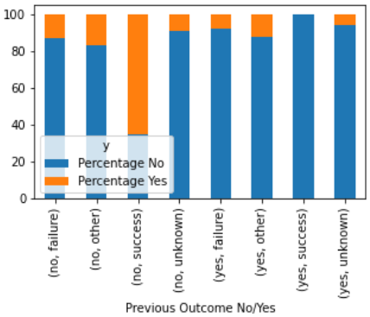
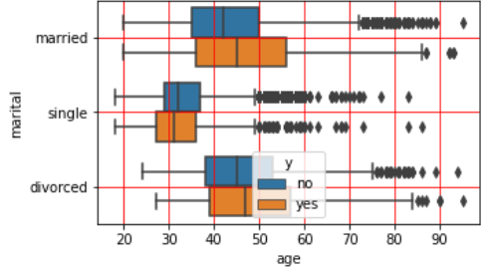
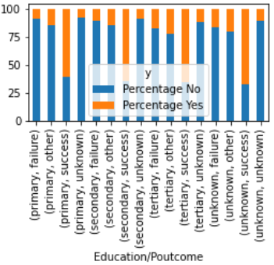
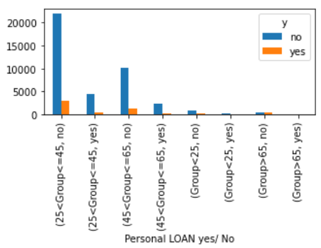
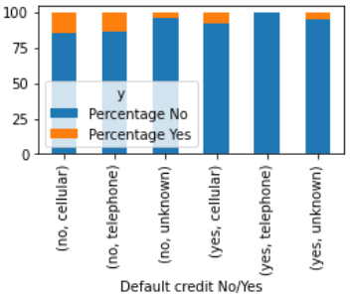
Multivariate Analysis
Default-Poutcome-Target
NONE of people who had default credit and subscribed in previous marketing campaign, subscribes again.
Marital-Age-Target
Education-Poutcome-Target
60-70% of people who subscribed in previous marketing campaign, subscribes again irrespective of education.
We conclude from the boxplot that the “Age feature” is highly corelated with the “Marital feature
Default-Contact-Target
NONE of the people who had default credit and who were contacted over telephone subscribed the term deposite.
Client without loan have subscribed the term deposite more irrespective of age groups.

Slide 8
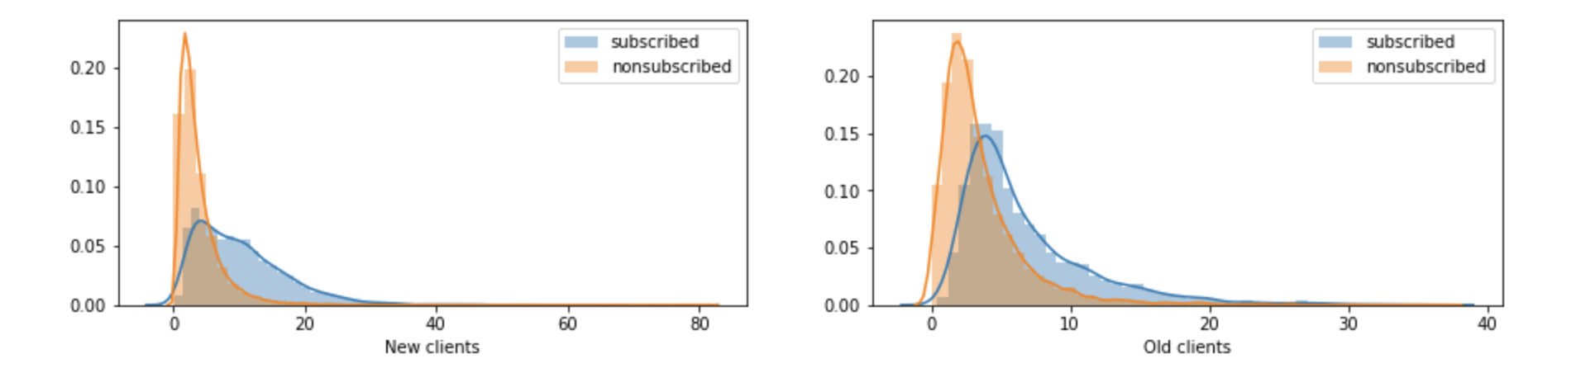
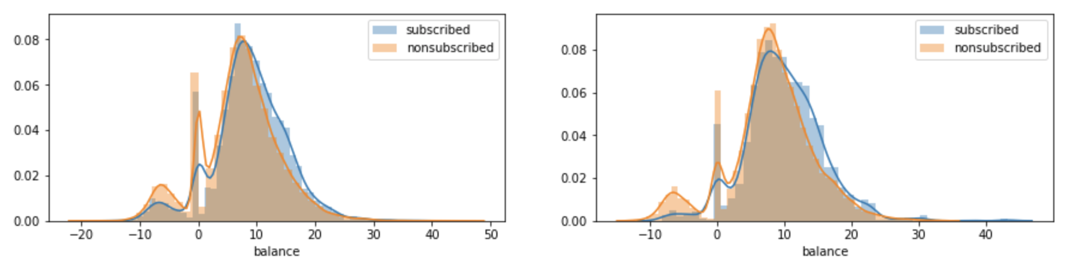
Exploratory Data Analysis(EDA)
On performing Numerical analysis – most patterns were normally distributed with significant skewness.
Conversion of old clients to invest into term deposits, significant call duration was required whereas for new clients, the call duration was significantly lower.
New Clients vs Duration Plot
Old Clients vs Duration Plot
Observed that term deposit balance is similar for both subscribed clients, irrespective of whether they are new clients or old clients.
New Clients vs Balance Plot
Old Clients vs Balance Plot

Slide 9
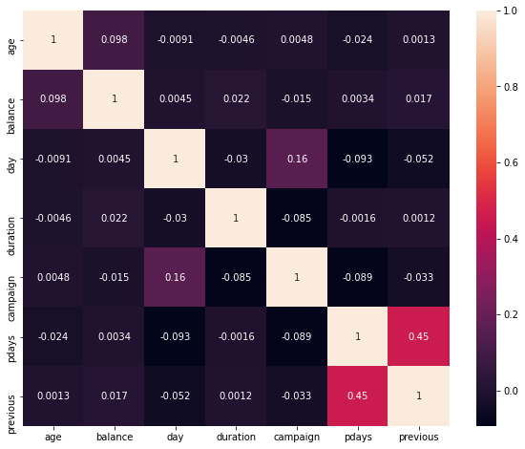
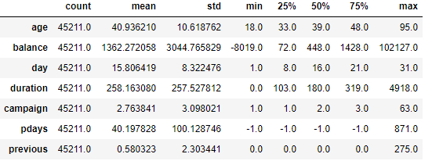
Correlation Matrix for All the Numerical Features :
Shows high correlation among pdays and p-revious -0.45

Slide 10
Statistical Inference and Pre-Processing
Statistical test of all the features with the target variable we conclude ,
2samp-independent T-test of mean, for age, balance & duration wrt target variable (yes/no) has significant effect, further more for balance taking zero balance and non zero balance as a feature estimating test of proportion we concluded that having zero balance has no significant effect on clients subscribing to Term Dep.
Where Job ,Marital status ,Having Credit card, Personal loan and Home loan is shows significance for accessing clients subscribing for Term Deposit. While accessing mode of contact as important feature we have also come to conclusion that cellular and telephonic mode of communication is more successful.
In education considering unknown which is 3% of the data as student , and evaluating test of proportions we conclude education to be a significant feature , similarly In context of days and month of contacting client, transforming month into quarters and Days into 3 different halves of the month has significant inference over target variable
Similarly for p-days, transforming feature into categorical aspect of Old Client and New Client has shown greater chance of old clients Subscribing on being approached in this campaign too.
Note: The data set contains a feature ‘duration’ which is the last contact duration, in seconds. Since the value is not known before a call is performed, and since the output value (yes / no) is known once the call is ended, this feature is removed for the predictive modelling. The labels (non-numerical) are encoded to numerical labels The data set consists of features with different data types; numeric and categorical. The numerical features were standardize by removing the mean and by scaling to unit variance (StandardScaler) There was one feature that can be considered as having Categorical Ordinal data type; education. This feature was converted to numerical representation using Ordinal Encoder (this results in single column of integers per feature. Integers are 0 to (no of categories - 1). All the other categorical features were nominal. So they were encoded to numeric using OneHotEncoder.

Slide 11
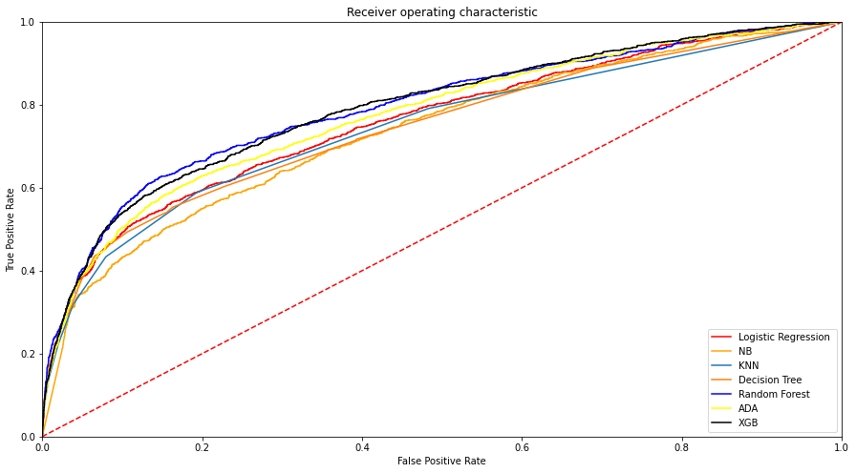
Algorithms and Conclusions
Target of Model : High sensitivity and low false negative ratio (high negative pred-value) as to reduce the cost of misclassifying a potential subscriber as non-subscriber.
As Our Base Model, the Classification Algorithm considered is Logistic Regression, which is statistical model that in its basic form uses a logistic function to predict our binary dependent variable(whether a client will subscribe to term deposit{‘yes’ or ‘no’})
Based on Cross-validation scores, other algorithm considered are:
❏ Decision Tree Classifier: This is a tree based model where the data are split according to the given parameters. For this problem, Gini impurity is used as the criteria to measure quality of a split, best split as the strategy to choose the split, maximum depth as 21 with 45 leaf nodes at most , minimum number of samples required to split as 4 and Complexity parameter used for Minimal Cost-Complexity Pruning as 0.002. (ccp-alpha)
❏ K Nearest Neighbors Classifier: This is a neighbor based method. This works directly on learned samples instead of creating rules. This method assigns the class of the majority of its k neighbors as the class of the test instance. For this problem, the best k value was 10.
❏ Naïve Bayes Classifier: This is a probabilistic classifier based on Bayes theorem of probability. Here, Gaussian is used as the probability distribution.
❏ XG Boost: is a decision-tree-based ensemble Machine Learning algorithm that uses a gradient boosting framework. For this Problem the hyper parameters considered after tuning are n_estimators =700, learning_rate =0.01 ,gamma=.5, max_depth=7, colsample_bytree=0.6
Algorothm | Crossval Scores Before Over Sampling
Logistic Regression | 0.8925292452599043
KNN Classifier | 0.8855894104376232
Decision Tree Classifier | 0.8928886629611823
Random Forest Classifier | 0.8931375108885063
ADA Boost Classifier | 0.7790282636040845
XGBoost Classifier | 0.8905108863992796
Naïve Bayes | 0.8543464295083194
❏ AdaBoost : classifier is a meta-estimator that begins by fitting a classifier on the original dataset and then fits additional copies of the classifier on the same dataset but where the weights of incorrectly classified instances are adjusted such that subsequent classifiers focus more on difficult 7cases. For this problem the hyper parameters considered post tuning, n estimators 250 and Learning_rate=1.
❏ random forest is a meta estimator that fits a number of decision tree classifiers on various sub-samples of the dataset and uses averaging to improve the predictive accuracy and control over-fitting. For this problem, Entropy as impurity is used as the criteria to measure quality of a split, with max features to be SQRT along with 250 estimators. maximum depth as 45 and minimum number of samples required to split as 8

Slide 12
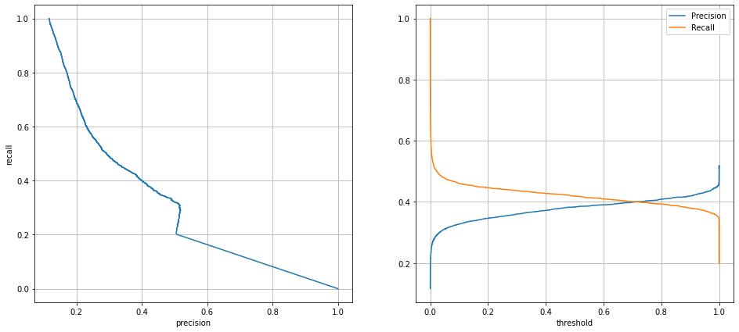
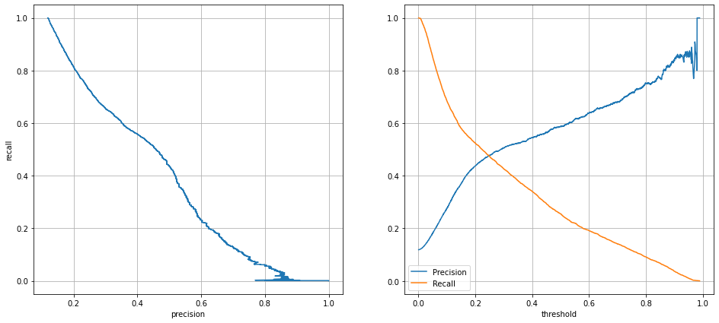
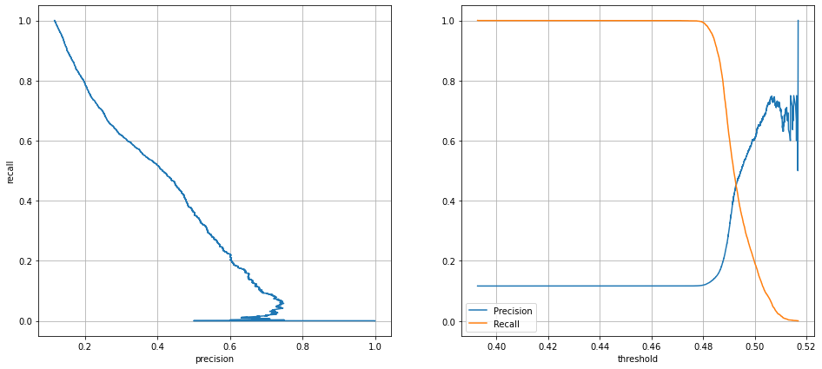
Performance Evaluation : Since this is an imbalanced data set, confusion matrix, precision, recall and F1 score are used along with the accuracy score, since accuracy score alone can be misleading. In this table, each cell for Precision, Recall and F1 score gives the scores for label ‘no’ and ‘yes’ respectively. F1 Score is used to select the best classifier since these scores are for an imbalanced data set and weighted average of F1 Score is used since it accounts this imbalance in its calculation. According to these results, accuracy score is proportional to the F1 Score weighted average. This is because the class imbalance was taken into consideration.
According to the above results, the highest F1 Score weighted average is scored by Naïve Bayes. The 2nd and 3rd best classifiers are Random Forest Classifier and XG Boost Classifier. Based on these results, considering f1 score , Roc Score and accuracy score we considered Naïve Bayes to be the algorithm used for this Model .
In Further Steps Since we are Not satisfied with the prediction of the Model , Over sampling is Going to be used for generating best prediction Model.
Classifier | Precision | Recall | Avg F1 Score
Logistic Regression | 0.90 0.68 | 0.99 0.18 | 0.61
KNN Classifier | 0.90 0.59 | 0.98 0.21 | 0.58
Decision Tree Classifier | 0.91 0.31 | 0.90 0.33 | 0.62
Random Forest Classifier | 0.90 0.66 | 0.98 0.23 | 0.64
ADA Boost Classifier | 0.90 0.63 | 0.98 0.20 | 0.62
XGBoost Classifier | 0.90 0.62 | 0.98 0.24 | 0.63
Naïve Bayes | 0.92 0.39 | 0.91 0.42 | 0.66
Precision Recall VS Threshold curve
Classifier | Roc Auc Score | Accuracy score
Logistic Regression | 0.7599 | 0.8906
KNN Classifier | N/A
Decision Tree Classifier | 0.7450 | 0.8357
Random Forest Classifier | 0.7927 | 0.8970
ADA Boost Classifier | 0.7750 | 0.8891
XGBoost Classifier | 0.7980 | 0.8909
Naïve Bayes | 0.7357 | 0.8520
RF
NB
XGB

Slide 13
Random Oversampling: Randomly duplicate examples in the minority class. Random oversampling involves randomly selecting examples from the minority class, with replacement, and adding them to the training dataset. They are referred to as “naive resampling” methods because they assume nothing about the data and no heuristics are used. This makes them simple to implement and fast to execute, which is desirable for very large and complex datasets.
Over Fitting Of Decision tree and Random Forest Algorithm :
❏ Decision Tree Classifier: For this oversampling problem, Gini impurity is used as the criteria to
measure quality of a split, best split as the strategy to choose the split, minimum number of samples
required to split as 2 and it is found that or Decision Tree model is Prone To Over-Fit.
❏ random forest is a meta estimator that fits a number of decision tree classifiers on various sub-samples of the dataset and uses averaging to improve the predictive accuracy and control over-fitting. For this problem, Gini as impurity is used as the criteria to measure quality of a split, with 100estimators. maximum depth as none and minimum number of samples required to split as 2. and it is found that or Decision Tree model is Prone To Over-Fit.
NOTE: Decision Tree and Random Forest Classifier shows very high precision and recall scores subjective to overfitting the data hence we can say that Decision tree and random forest Classifier DoesNot applies to this Model
Classifier | Precision | Recall | Avg F1 Score
Decision Tree Classifier | 1.00 0.90 | 0.88 1.00 | 0.95
Random Forest Classifier | 1.00 0.95 | 0.95 1.00 | 0.98
❏ XG Boost classifier : a decision-tree-based ensemble Machine Learning algorithm that uses a gradient boosting framework, For this case of over sampling Dataset the hyper parameters considered post tuning by randomized Search CV , n estimators 700 , Learning_rate=0.1, gamma=1.5, max_depth=5, subsample=0.8.
❏ AdaBoost : classifier is a meta-estimator that corrects weights of estimators to adjust co-eff. For this problem the hyper parameters considered post Randomized Search CV tuning, n estimators 750 and Learning_rate=1.
❏ K Nearest Neighbors Classifier: This is a neighbor based method. For this problem, the best k value was 7. Model is prone to overfit on changing weights =‘Distance’ and algorithm =‘Brute’
Classifier | Precision | Recall | Avg F1 Score
Logistic Regression | 0.67 0.74 | 0.77 0.63 | 0.70
KNN Classifier (TUNED) | 0.92 0.77 | 0.72 0.94 | 0.83
ADA Boost Classifier | 0.69 0.77 | 0.80 0.65 | 0.73
XG Boost Classifier | 0.83 0.86 | 0.87 0.82 | 0.85
Naïve Bayes | 0.62 0.79 | 0.87 0.47 | 0.66
Algorothm | Crossval Scores Before Over Sampling
Logistic Regression | 0.7061761252446184
KNN Classifier | 0.7061761252446184
Decision Tree Classifier | 0.9669980430528377
Random Forest Classifier | 0.997816222304283
ADA Boost Classifier | 0.721518590998043
XGBoost Classifier | 0.8203993068065719
Naïve Bayes | 0.6741918339723997

Slide 14
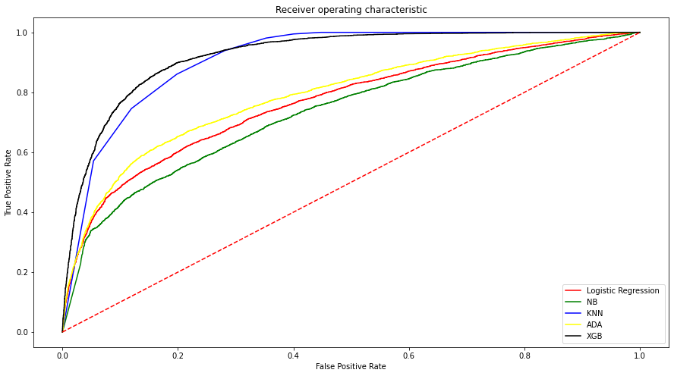
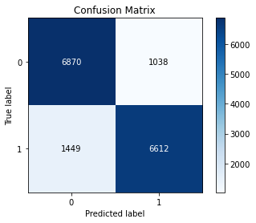
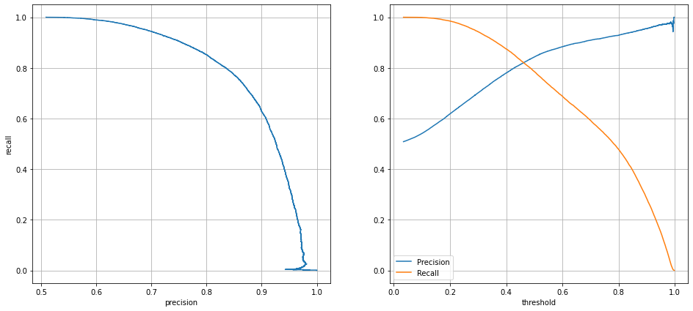
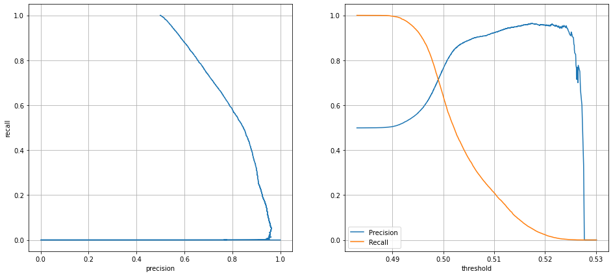
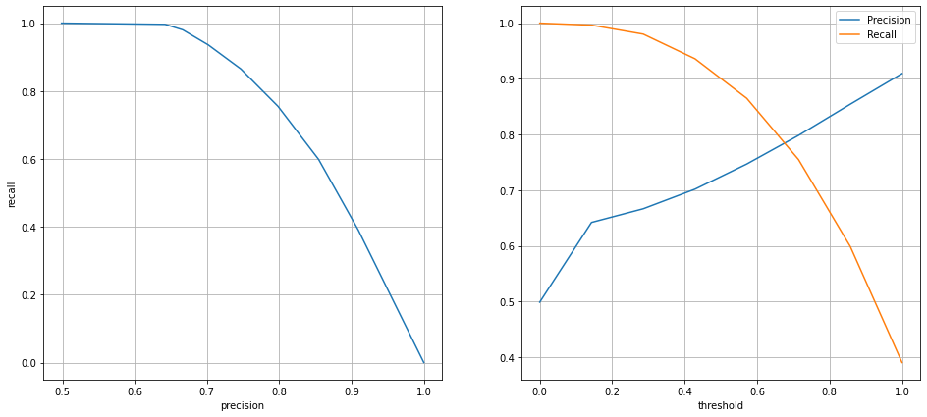
Performance Evaluation : Since this was animbalanced data set, and then after Oversampling y (yes/no) are in same proportion, confusion matrix, precision, recall and F1 score are used along with the accuracy score, to select the best model.
In This Case based on Precision, Recall, F1 score, Accuracy score and Roc Curve we can clearly identify that our first best Model is XG Boost Classifier while 2nd and 3rd best classifiers are KNN Classifier and ADA Boost Classifier.
Classifier | Roc Auc Score | Accuracy score
Logistic Regression | 0.7671 | 0.7004
KNN Classifier | N/A | 0.8301
ADA Boost Classifier | 0.7904 | 0.7256
XGBoost Classifier | 0.9232 | 0.8442
Naïve Bayes | 0.7336 | 0.6677
Precision Recall curve
KNN
XGB
ADA

Slide 15
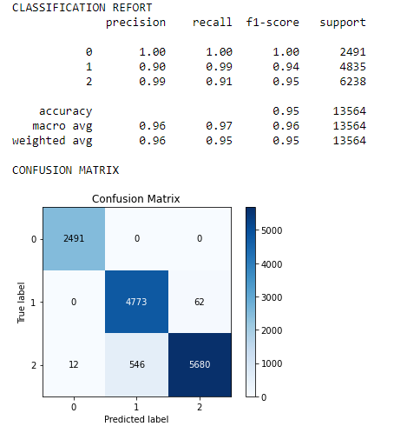
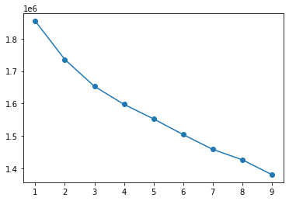
K Means Clustering
Unsupervised Learning Employed to access the accuracy of the data set and analyze the possible classes expected,
K-Means Clustering is an unsupervised learning algorithm that is used to solve the clustering problems in machine learning or data science. In this topic, we will learn what is K-means clustering algorithm, how the algorithm works, along with the Python implementation of k-means clustering. In our Problem statement obtained Elbow curve pointed out 3-4 clusters moving ahead with 3 cluster’s , then adding those labels as 0,1,2 and training on our best model for dataset without over sampling (Naïve Bayes )we reached the following classification matrix.
We can conclude that the outcome of bank Marketing is not enclosed to Yes/No , more diversity is present

Slide 16
Thanks!

